Slide 1
Physical Activity Planning and Safety

Slide 2
Planning Fitness Activities
Pick a person to create an activity plan for. They may be real or fictional.
Think about factors that would influence the kinds of physical activities they would participate in.
Describe 3 physical activities they could participate in.

Slide 3
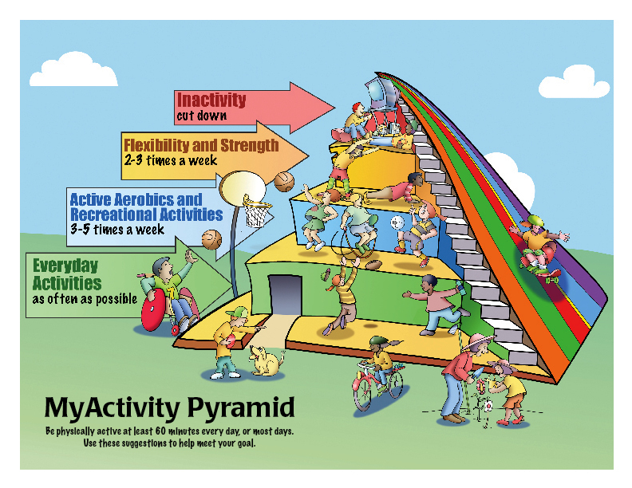

Slide 4
Recommendations for Physical Activity
Type | Recommendation | Examples
Moderate Intensity | 30 minutes a day | Walking, Climbing Stairs, Yard Work
Aerobic | 3 to 5 days a week 20 to 60 minutes per session | Running, Basketball, Cycling, In-line Skating
Anaerobic | 2 to 3 days per week | Push-Ups, Biceps Curl, Bench Press
Flexibility | 2 or more days per week | Side Lunge, Yoga, Calf Stretch
Sedentary | Do infrequently | Watching TV, Facebook, Video Games

Slide 5
Basics of an Activity Program
Overload – working the body harder than it is normally worked
Increasing repetitions or doing more sets
Progression – the gradual increase in overload necessary to achieve higher levels of fitness
As an activity becomes easier, do more sets or increase the amount of time
Specificity – particular exercises and activities improve particular areas of health-related fitness

Slide 6
Activity Routine
Stages of Activity
F.I.T.T. Formula
Warm-Up – an activity that prepares the muscles for work
Workout – the part of an exercise program when the activity is performed at its highest peak
Follows the F.I.T.T. formula
Cool-Down – an activity that prepares the muscles to return to a resting state
Frequency – how often you do the activity each week
Intensity – how hard you work at the activity per session
Time/ Duration – how much time you devote to a session
Type – which type of activities you select

Slide 7
Training and Peak Performance
Training Program – a program of formalized physical preparation for involvement in a sport or another physical activity
The first step is to take care of your body:
Get proper nutrition and hydration
Hydration – taking in fluids so that the body functions properly
Get adequate rest
Avoid harmful substances
Anabolic Steroids – synthetic substances that are similar to the male hormone testosterone

Slide 8
Safety First
Reduce your risk of injury by:
Get a health screening – a check for diseases or disorders that an individual would otherwise not have knowledge of or seek help for
Know your physical limits
Obey rules and restrictions
Warm-up and cool-down
Practice good sportsmanship
Use proper equipment
Protective equipment such as helmets, knee pads, wrist guards and athletic supporters or cups
Footwear and clothing

